Slide 1
Heart Disease Predictions
GA Final Project - Justin Moss

Slide 2
Objective
Based on the observed parameters, predict if a given set of characteristics puts a patient at risk for heart disease

Slide 3
Data Dictionary
- Age: age of the patient [years] - Sex: sex of the patient [M: Male, F: Female] / [0: Female, 1: Male] - ChestPainType: chest pain type [TA: Typical Angina, ATA: Atypical Angina, NAP: Non-Anginal Pain, ASY: Asymptomatic] - RestingBP: resting blood pressure [mm Hg] - Cholesterol: serum cholesterol [mm/dl] - FastingBS: fasting blood sugar [1: if FastingBS > 120 mg/dl, 0: otherwise] - RestingECG: resting electrocardiogram results [Normal: Normal, ST: having ST-T wave abnormality (T wave inversions and/or ST elevation or depression of > 0.05 mV), LVH: showing probable or definite left ventricular hypertrophy by Estes' criteria] - MaxHR: maximum heart rate achieved [Numeric value between 60 and 202] - ExerciseAngina: exercise-induced angina [Y: Yes, N: No] - Oldpeak: oldpeak = ST [Numeric value measured in depression] - ST_Slope: the slope of the peak exercise ST segment [Up: upsloping, Flat: flat, Down: downsloping] - HeartDisease: output class [1: heart disease, 0: Normal]

Slide 4
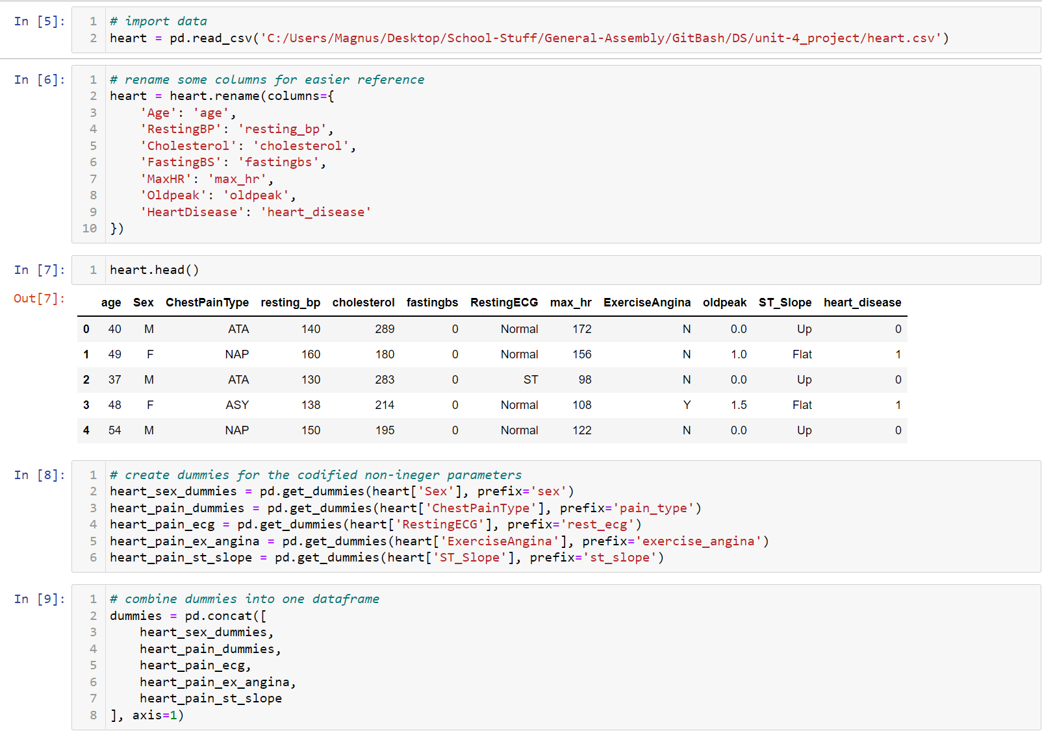
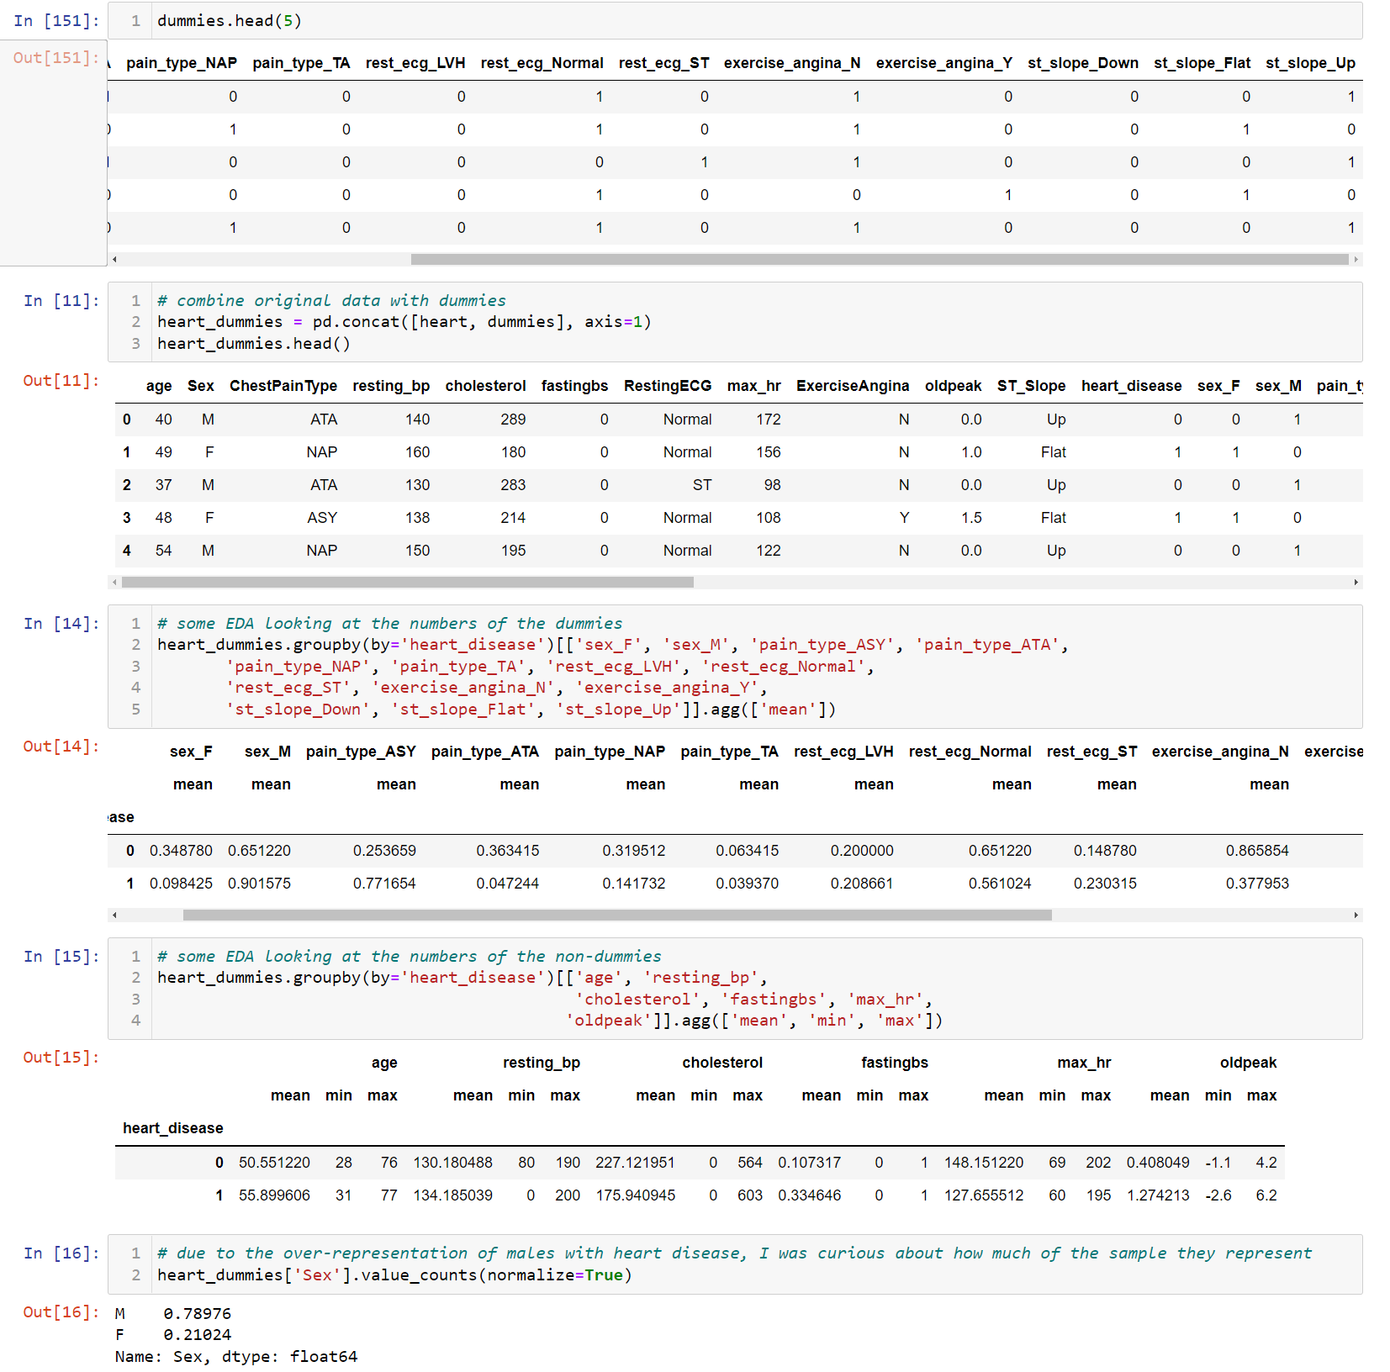
First Steps:
Loading in the data, renaming columns for ease of use, and some EDA.

Slide 5
EDA Observations:
- 55% of samples have heart_disease - Age Range is from 28 to 77, with no significant separation in average age - 90% of heart disease cases are men despite making up only 79% of the samples - No significant separation in average resting Resting BP - Heart disease cases typically have lower cholesterol - Heart disease cases typically have lower max heart rates - 33% of heart disease cases have fasting blood sugar over 120 mg/dl - 77% of heart disease cases have ASY pain type (asymptomatic ie: no pain) - 56% of heart disease cases have normal resting ECG - 62% of heart disease cases have Exercise Angina - Higher oldpeak positively associated with higher risk of heart disease - Flat ST Slope for 75% of heart disease cases

Slide 6
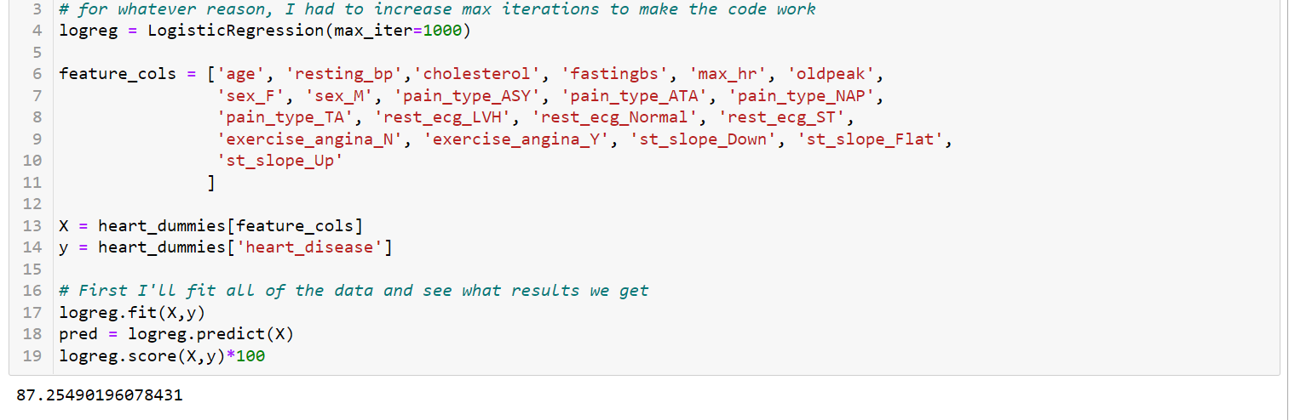
Moving forward:
Since we are predicting a binary value, we will use a Logistic Regression. We’ll use all of the parameters as our features.
Fitting with all of the data gave an accuracy of ~87%

Slide 7
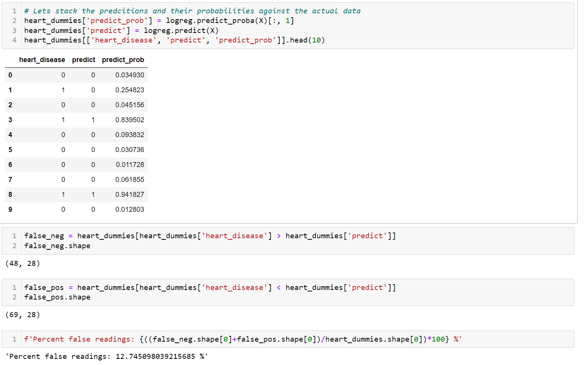
More False Negatives or Positives?
As this is something as serious as a heart attack, I would rather a potential patient received a false positive and sought care instead of a false negative. There will always be a tradeoff there. (more on that later)

Slide 8
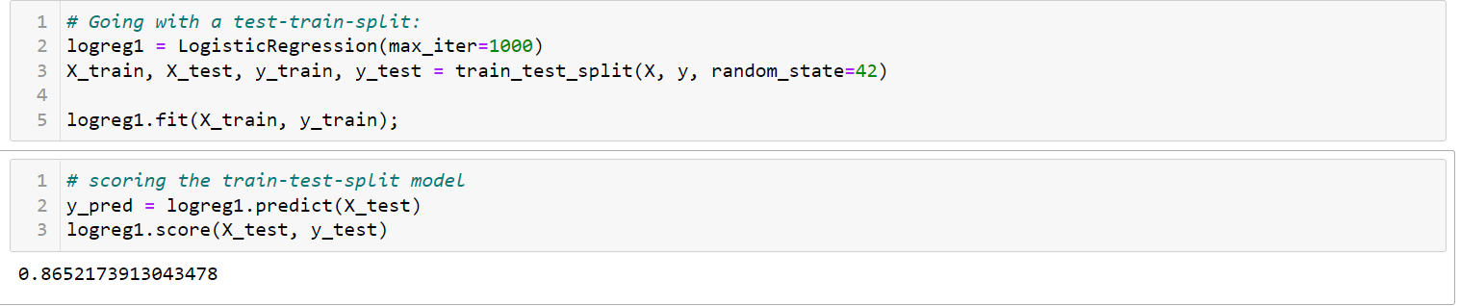
Train-Test-Split?
Our score falls slightly with a train-test-split, which of course means we’re more generalized now, but we can do better.

Slide 9
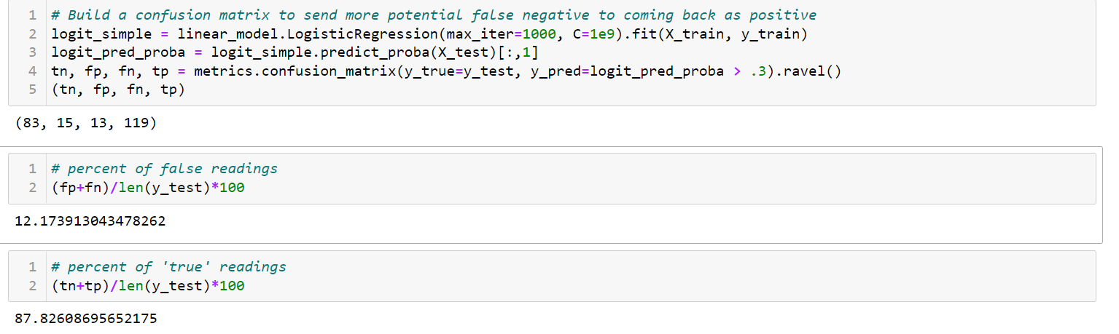
Confusion Matrixing, Altering Threshold
Using a confusion matrix, we will change the threshold for a positive indication of heart disease to ‘.3’ for the probability. We now have significantly fewer false scores.

Slide 10
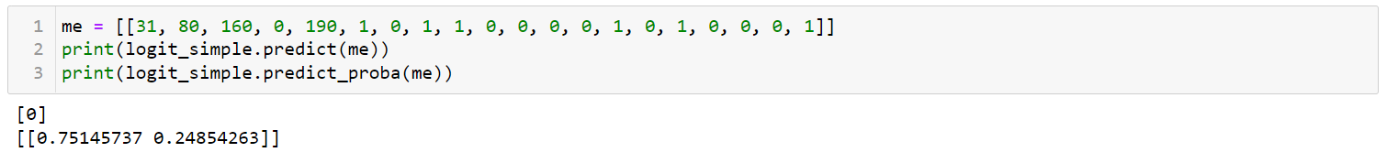
Am I at risk?
I made some assumptions as I’ve never heard of oldpeak or ST Slope before this project, but I should be fine for now.

Slide 11
Conclusions:
Based on our findings with the confusion matrix possibly creating more false positives, I am personally not presently at risk for heart disease. In the future, we could expand the number of observations and take in more health data such as: - Is the patient a smoker? - Do they exercise regularly? - Body-mass Index - etc.
Additionally, I could clean up the dummies to bring it closer to a binary. In particular: - Sex could be 0=male 1=female - Pain types could have three columns for the actual pains, with asymptomatic being all 0s - same with resting ecg, st slope, exercise angina

Slide 12
Questions?
Data sourced from: https://www.kaggle.com/datasets/fedesoriano/heart-failure-prediction

